Slide 1
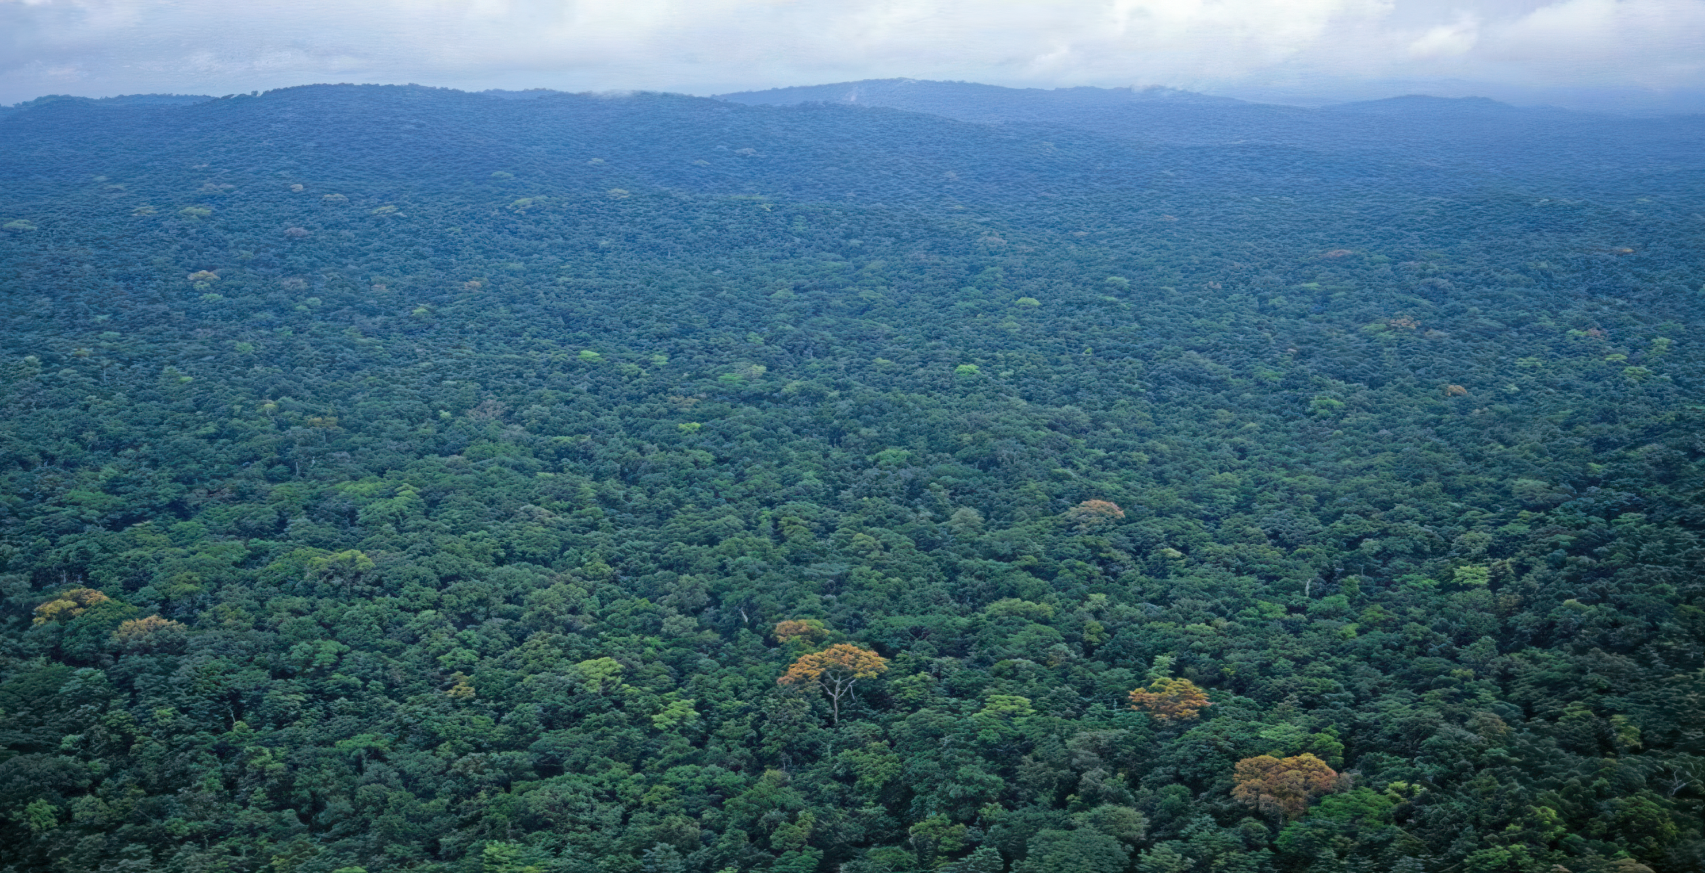
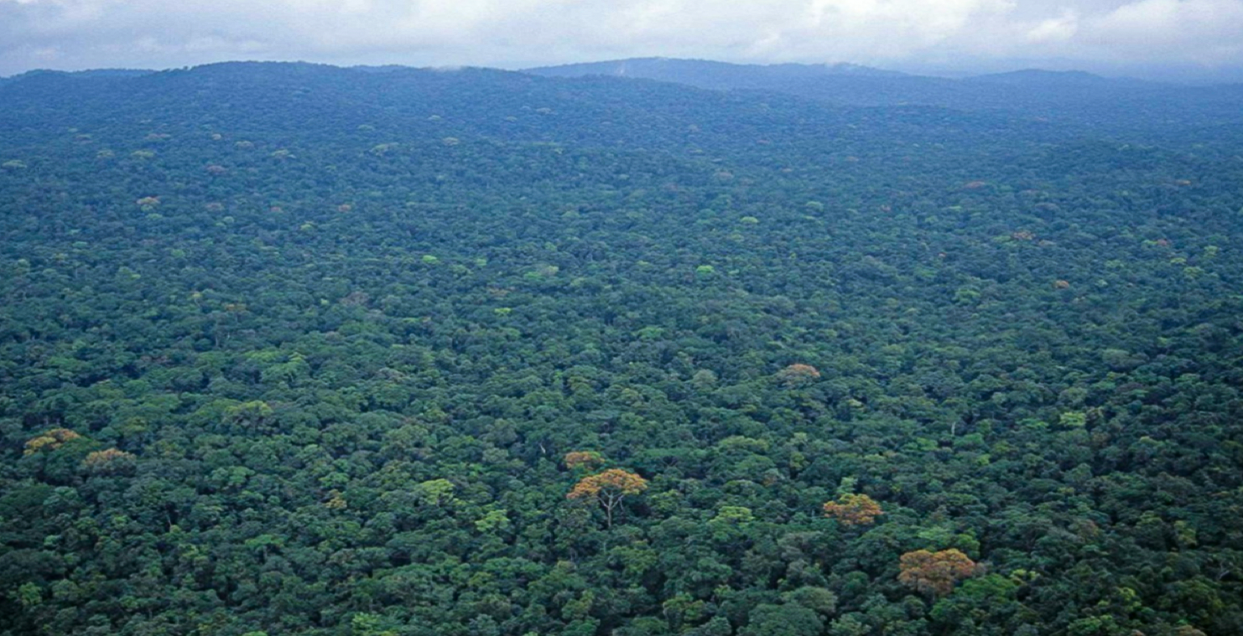

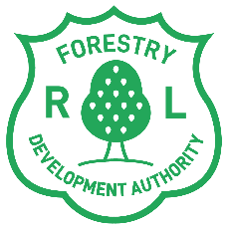
FORESTRY DEVELOPMENT AUTHORITY (FDA)
Liberia’s National Forest Forum 2025
Monday – Wednesday, November 3-5, 2025
Securing Customary Land Rights: The foundation for sustainable development
Presented by:
Acting Commissioner
Land Policy and Planning
Liberia Land Authority

Slide 2
Securing Customary Land Rights: The foundation for sustainable development

Slide 3
The Imperative for Land Reform
The Problem: A Legacy of Exclusion and Conflict
Legal marginalization
Institutional overlap
Consequence
Customary communities long treated as “occupants,” not owners.
Fragmented mandates across LME, FDA, MoA, MIA
Overlapping concessions, weakened community rights, conflicts, and distrust
The Solution: The Land Rights Act (2018)
Formally recognizes customary land as legally owned
Restores rights and builds trust for sustainable development
Notes:
Talking point: We cannot effectively manage forests, mines, or agriculture without first resolving the fundamental question: who owns and controls the land?

Slide 4
Legal Framework for Reform
Law / Instrument | Core Function
Community Rights Law (2009) | Recognizes community forest rights; creates Community Forest Management Bodies (CFMBs).
Liberia Land Authority Act (2016) | Establishes the LLA as the central land administration body.
Land Rights Act (2018) | Recognizes customary land ownership; mandates inclusive Community Land Development & Management Committees (CLDMCs).
Notes:
Talking point: “When governance is unclear at the community level, it creates a vacuum for conflict and abuse.”

Slide 5





Post-War Reforms: Strategic Objectives
Reforms aim to:
Reduce land-related conflicts
Clarify institutional roles
Secure customary land rights
Strengthen community-investor relations
Attract responsible investment in forestry, agriculture, Mining, and climate markets
01
02
03
04
05
Notes:
Talking point: “This is not a documentation exercise—it’s an investment in stability, accountability, and inclusive development.”

Slide 6
Navigating Legal Integration: Gaps and Risks
01
Representation:
CFMB, CLDMC, or Chief—who speaks for the community?
CRL, 2009
LRA, 2018
Empowers CFMBs for forest management and revenue
Establishes CLDMCs for inclusive land governance
Gaps and risks
Accountability:
Unclear or fragmented benefit-sharing mechanisms.
02
Mandate tension: forest–land–mineral interface:
FDA, LLA, EPA, and MME roles remain misaligned.
03
Notes:
Talking point: “This is not a documentation exercise—it’s an investment in stability, accountability, and inclusive development.”

Slide 7
Status of Customary Land Formalization
What LLA is doing now

Slide 8
Strategic Land Use; Public Purpose Allocation
The LRA allows up to 10% of land for public purposes—commercial, conservation, Carbon, and infrastructure use.
The National Land Use Policy reduces pressure on community land and guides national development.
It also supports artisanal livelihoods by clarifying zones for shared use and responsible local investment.

Slide 9
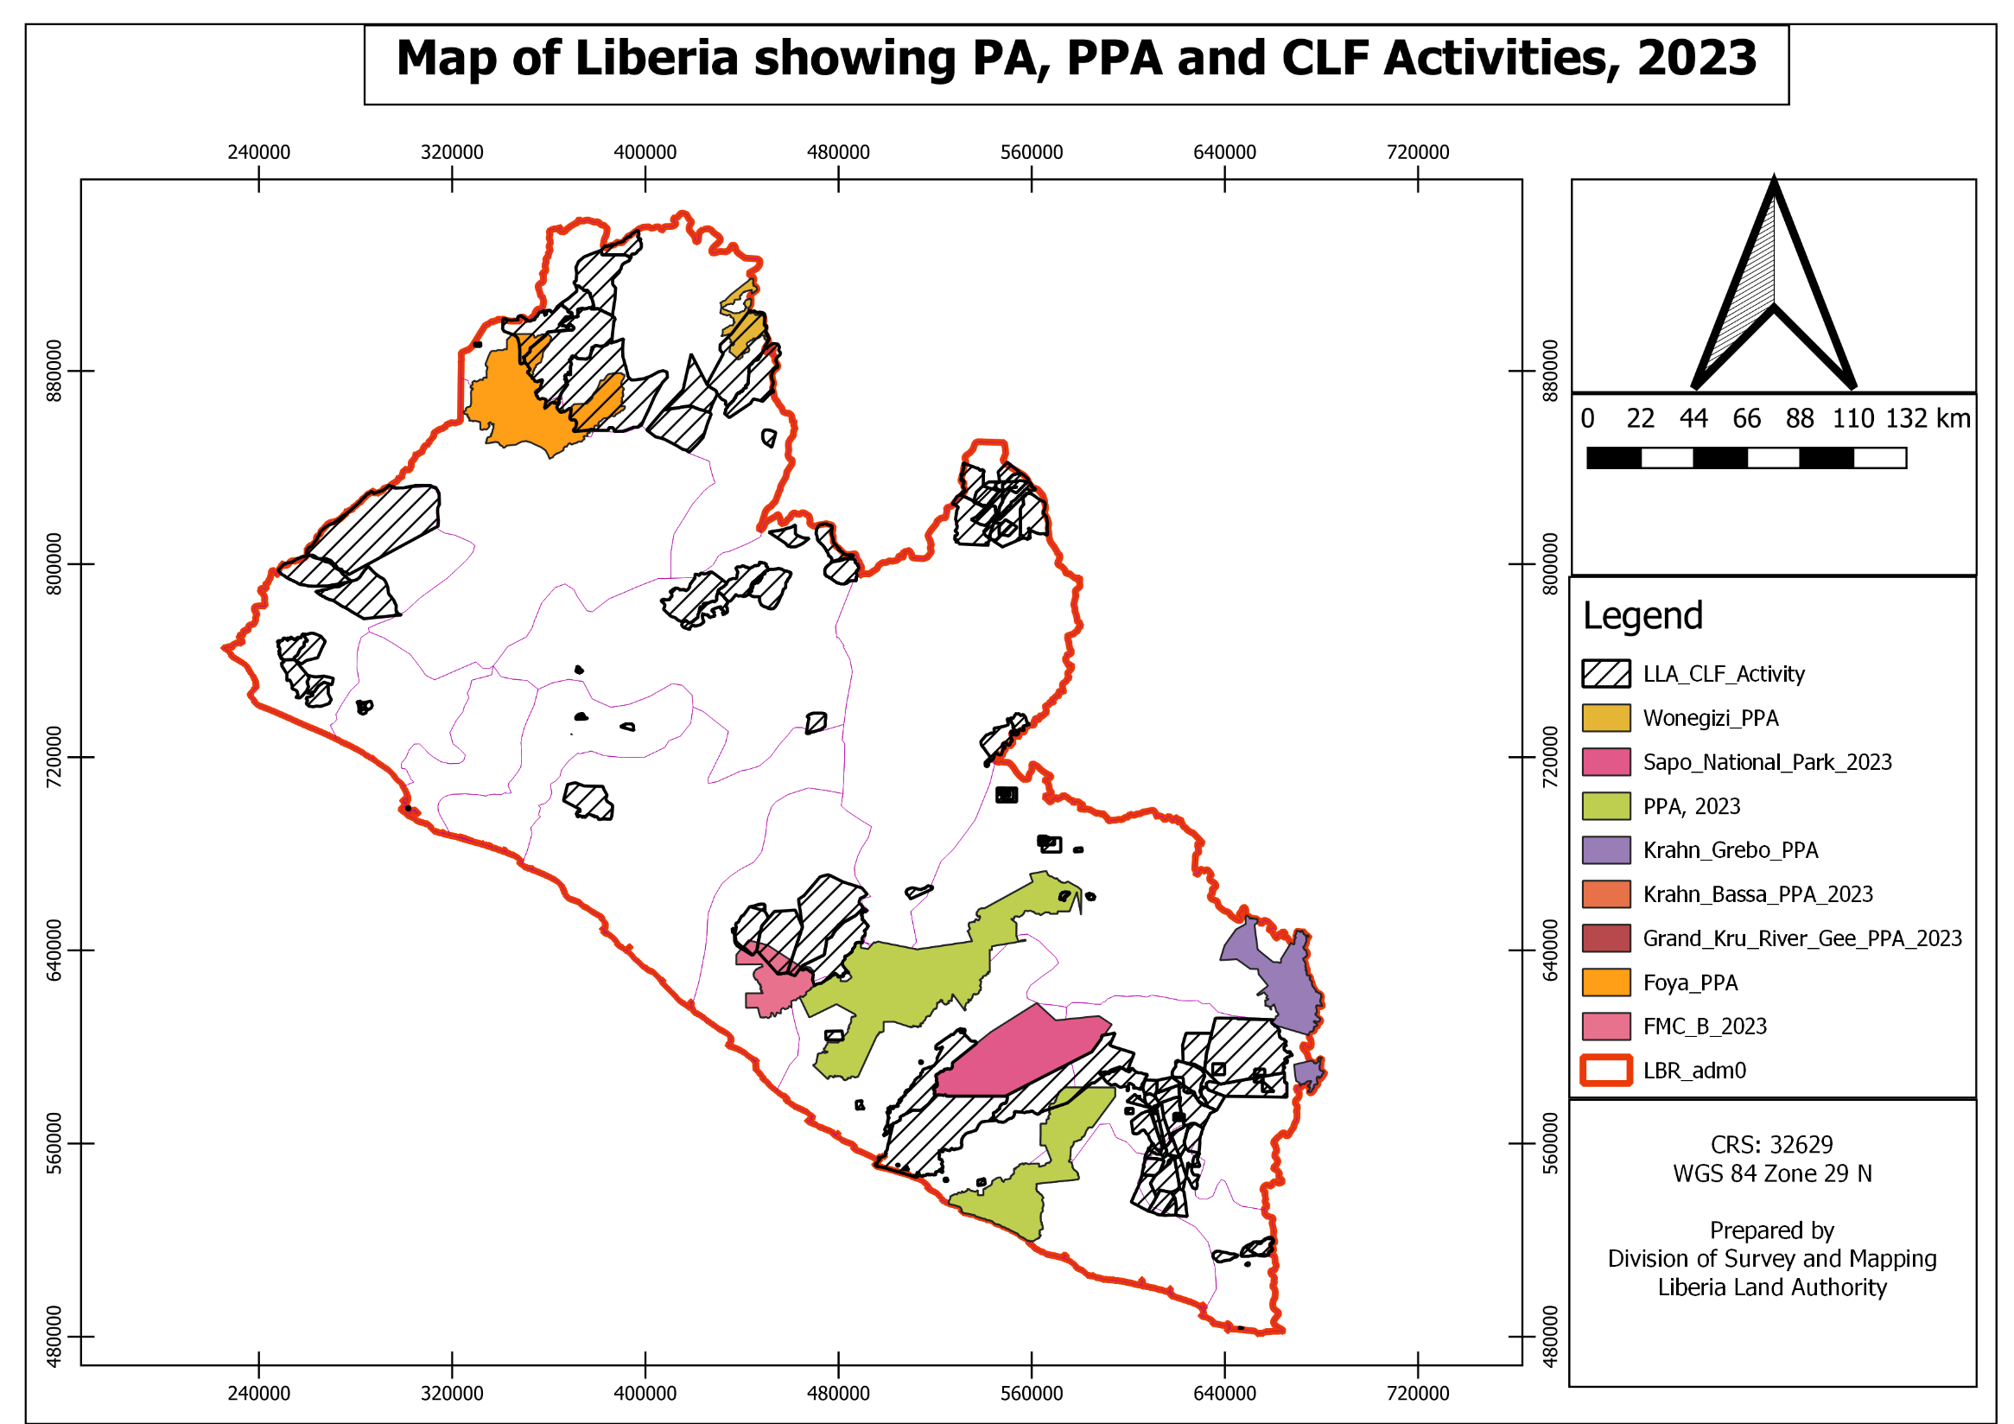
Strategic Land Use; Public Purpose Allocation
The LRA allows up to 10% of land for public purposes: Commercial, conservation, Carbon, and infrastructure use.
Integrated National Land Use Policy & Plan: reduces pressure on community land and guides national development.
Supports artisanal livelihoods by clarifying zones for shared use and responsible local investment.

Slide 10
Community Capacity: The Critical Gap
Many communities lack the technical, managerial, and financial capacity to manage newly formalized rights.
Without support, legal recognition may not translate into effective governance or sustainable use.

Slide 11
Next Step
Assess CLF impact: Measure effects on conflict, tenure security, productivity, and investment.
Clarify governance roles: CLDMCs and CFMBs to reduce overlap and strengthen coordination and accountability.
Strengthen coordination: Improve institutional alignment across LLA–FDA–MME–MoA–MIA-EPA for coherent land and forest governance.
Develop a national land-use plan: Guide agriculture, mining, forestry, conservation, and carbon decisions.
Assess Government Support Needs: Define and fund the state’s role in helping communities manage land and resources.
Implement the LRA: Protect legal gains—any rollback risks renewed tension and weakens Liberia’s leverage in forest and climate negotiations.

Slide 12
Closing
Protecting land rights through an integrated land use and management regime strengthens—not weakens—state authority. It builds trust, legitimacy, and sustainable management for generations to come.

Slide 13
THANKS

